Slide 1
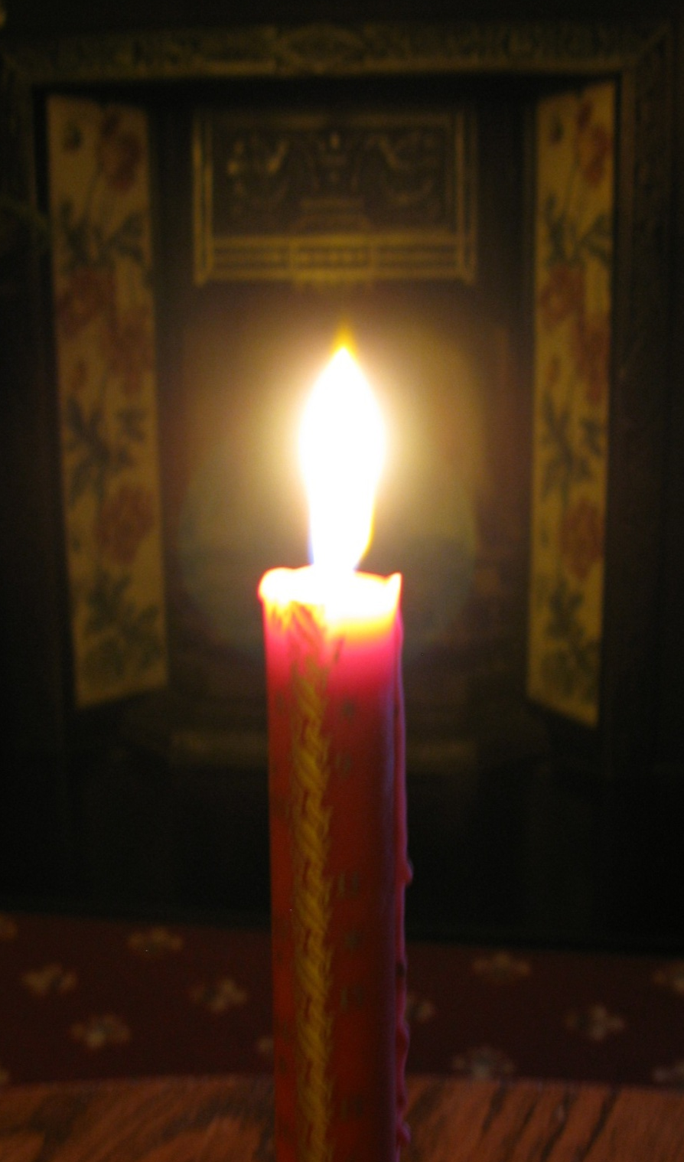

Lord Jesus,
We wait
For you to come.
And yet, you are already here.
Help us to feel your presence,
To share the stillness with you.
So that after a while
We see your light
Shining out from within.
Amen

Slide 2

Credits:
Music by Simeon Wood - ‘The Journey’ 2003
www.simeonwood.com
Words and image by Claudia Brown of Sanctuary 242.
Sanctuary242@hotmail.co.uk
Sanctuary is an intentional Christian community based in and around St Albans, England. We are a group of people who are exploring the boundaries between the rich traditions of the inherited Christian church and the challenges we face living in a modern secular society. Sanctuary provides a safe haven to explore the space around us – culture, church, friendship, family, life. Together we undertake a journey of invitation through shared understandings and explorations of bible and story, teaching and experience, fellowship and prayer, deeply founded upon the loving purposes of our God, becoming disciples of Jesus Christ to our modern world.

